Slide 2
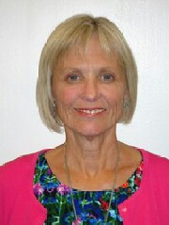
CODE IMPLEMENTATION WORKSHOP (7 SEPTEMBER)
BIOPHARMACEUTICAL SECTOR
Introductory Remarks
Ms. Lynn Costa, Project Overseer
Business Ethics for APEC SMEs Initiative
& Senior Advisor, U.S. Department of Commerce

Slide 3
CODE IMPLEMENTATION WORKSHOP (7 SEPTEMBER)
BIOPHARMACEUTICAL SECTOR
Participant Introductions
NAME │ POSITION │ ORGANIZATION │ ECONOMY

Slide 5
CODE IMPLEMENTATION WORKSHOP (7 SEPTEMBER)
BIOPHARMACEUTICAL SECTOR
Driving Code Implementation:
Governance, Alignment,
& Member Adherence

Slide 6
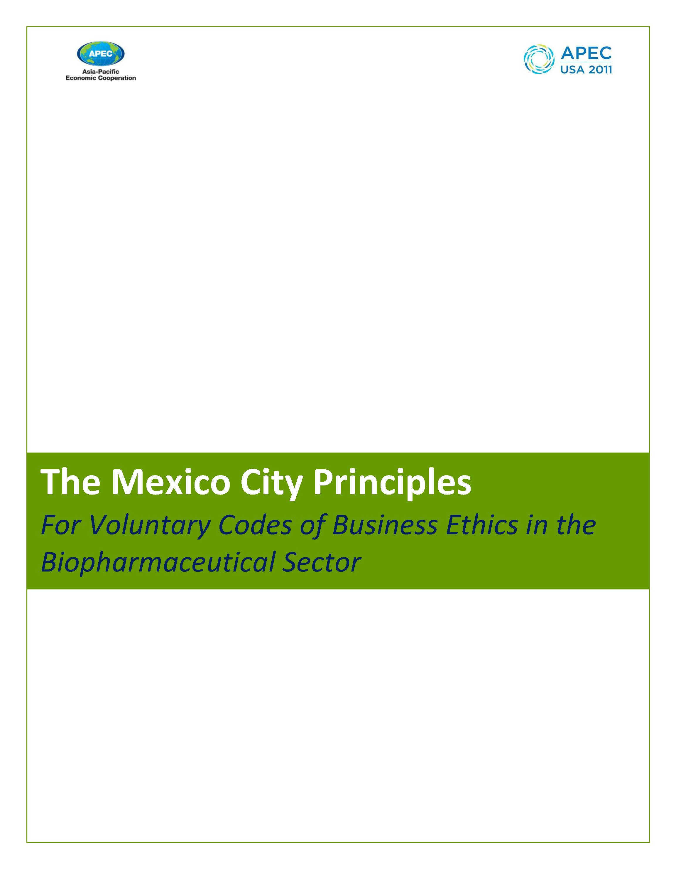
A Six Year Journey from Mexico City to Hanoi

Slide 7
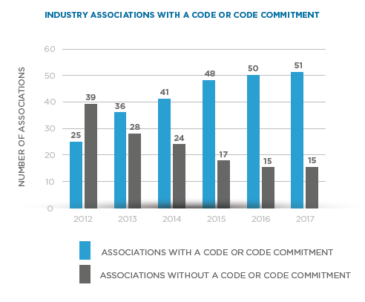
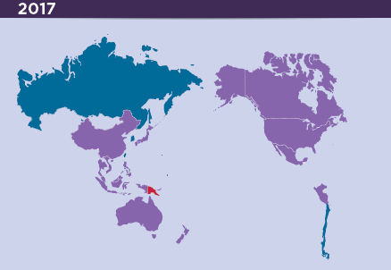
Widespread Industry Association Code Adoption

Slide 8
The “Big Three” in
Successful Industry Assn Code Implementation
Code Governance – is it legitimate and alive…
Code Alignment – is it a quality code of ethics…
Member Implementation – is it being adhered to by enterprises in daily business practice…
+ External Engagement – is the code understood and embraced by other stakeholders in the health system…

Slide 9
CODE GOVERNANCE
Strong leadership commitment, membership endorsement, and overall governance, but…
A decline in code dissemination to external stakeholders and limited code trainings / one-on-one assistance suggests resource challenges.

Slide 10
CODE ALIGNMENT
A genuine success story: the region is aligning with the APEC Mexico City Principles!
81% report the code embraces all six principles
Alignment numbers are increasing each year…
11% decrease in the number of associations that make training available to HCPs / other groups

Slide 11
MEMBER IMPLEMENTATION
APEC monitoring continues to improve…
76% of associations indicate the code has performed excellent or well, with at least 69% reporting a majority of members follow the code
Non-member dilemma remains a key challenge
Philippines (PHAP) pilot enterprise survey

Slide 12
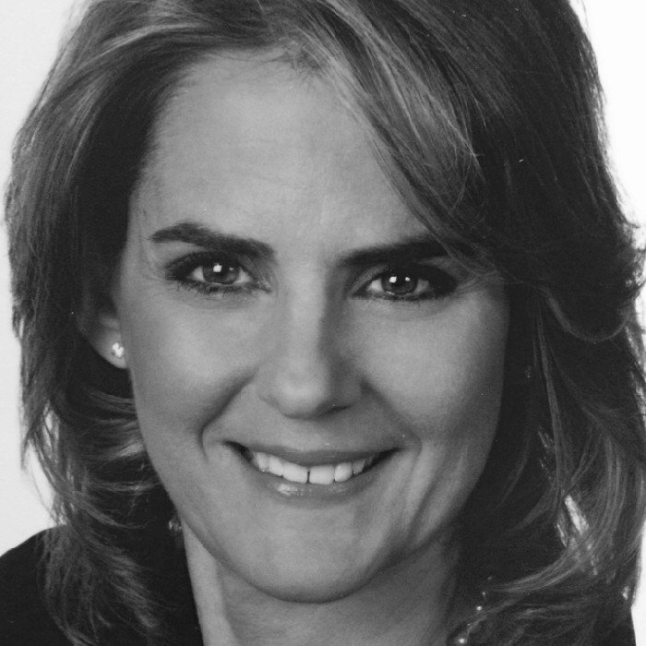
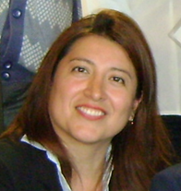
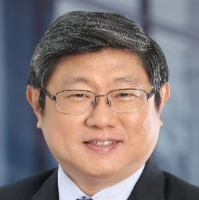
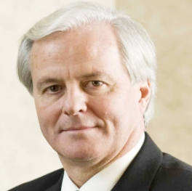
CO-CHAIRS PANEL
Ms. Chris Nikidis INDUSTRY CO-CHAIR APEC Biopharmaceutical Working Group on Ethics CANADA | Ms. Rocio Delgado GOVERNMENT CO-CHAIR APEC Biopharmaceutical Working Group on Ethics PERU | Dr. Kenneth Hartigan-Go HCP CO-CHAIR APEC Biopharmaceutical Working Group on Ethics THE PHILIPPINES | Mr. Russell Williams PATIENT CO-CHAIR APEC Biopharmaceutical Working Group on Ethics CANADA

Slide 13
KEY QUESTIONS:
What does success in driving code implementation look like to you? Consider opportunities and challenges.
What is my responsibility to ensure success in driving code implementation?

Slide 14
INTERACTIVE EXERCISE
What does success in driving code implementation look like to you? Consider opportunities and challenges.
What is my responsibility to ensure success in driving code implementation?
Designate a table facilitator, ten minute discussion, then your facilitator will report back to the full workshop.

Slide 15
INTERACTIVE EXERCISE / TABLE FEEDBACK
Political Leadership
Internal training and awareness building
Role of civility society in mobilzing change self-regulation is a responsibility
Training of medical sales representatives / October collaboration opportunity in Beijing
Strengthening focus on daily business practices and changing cultural approaches
Achieving industry code alignment across health systems / collaboration with government to achieve alignment in best practices
Commit to make issue more interactive and engagement across different settings
Tone at the top across multiple economies and settings / standard approach
Collective understanding and approach, Forums for dialogue, consultative and partner approach, strengthening and building a positive brand for the sector
Peer to peer approach
Stakeholders to accept and internalize Codes: include in university curriculm
Have stakeholders embrace that ethical behaviour is important
Ownership and accountability-align on the success of implementation
Cultural change- how can we influence
Training both internally and externally
Response to increase transparency –reframe in the broader society requirement
Tone from the top
Dissemination
Reconcile laws and self regulation
Stakeholders are all aligned on common ethical practices
Tracking and monitoring code implementation
How do we effectively share with our stakeholders
Put the patient at the center of the conversation around strengthening ethical business practices. How to perform multi-sectoral training in limited resource settings?
Sharing information across borders on best
KEN: Scale our efforts and continue major objectives
CHRIS: Build better training and outreach program. Tools and resources.
ROCIO: Aligning codes of ethics, minimize gaps within health systems. Trust-based approach.
RUSSELL: Focus on measurement and metrics to assess progress. Where can we improve? Think about expanding commit

Slide 17
MULTI-STAKEHOLDER
COLLABORATION IN VIET NAM
TO STRENGTHEN ETHICAL
BUSINESS PRACTICES

Slide 18
BREAKOUT SESSIONS ON
ADVANCING CODE OF ETHICS IMPLEMENTATION
11:30-12:30 / 13:30-15:00
WHERE SHOULD I GO?
Introductory Course: Song Hong Room 1 & 2 (same room)
Advanced Course: Song Lo / Thao Room (across hallway)
Note: Simultaneous interpretation only available in Introductory Course room
PLEASE REMAIN IN YOUR CHOSEN COURSE

Slide 19
INTRODUCTORY BREAKOUT SESSIONS (COURSE A)
ADVANCING CODE OF ETHICS IMPLEMENTATION
11:30-12:30 / 13:30-15:00
SCHEDULE OF MODULES
Internal Considerations (Deborah, Amy, Ted, Busakorn, DD, Janet, Sofie)
External Considerations (Katsumi, Rafizah, Cris, Thuy, Neil)
Time Permitting: Individual / Small Group Mentor Sessions

Slide 20
MODULE ONE:
INTERNAL CONSIDERATIONS

Slide 21
OVERVIEW
This workshop is intended to assist economies who are at earlier stages of developing and implementing a Code of Practice by their member companies and other companies.
We are going to work on three Case studies together, designed to stimulate thinking and discussion, in the imaginary country “Malicuria”:
Case 1 – No Code of Practice – how to start this process and engage appropriate stakeholders
Case 2 – Code of Practice recently adopted, but implementation variable and needs strengthening
Case 3 – A Code of Practice has been adopted; how to maintain implementation and keep the Code up to date

Slide 22
COURSE A TIMELINE
11.00-11.15 Line-up Ice Breaker & Group Setting
11.15-11.20 Introduction to Malicuria
11.20-11.55 Case study work in 3 groups
(one Case study per group)
11.55-12.25 Presentation of results & discussion (5 + 5 min per group)
12:25-12:30 Wrap-up and close

Slide 23
YOUR FACILITATORS
Each group will have two facilitators to assist your discussions:
Case Study 1: Sofie Melis and Duangduen Sahavechaphan
Case Study 2: Amy Huang and Deborah Monk
Case Study 3: Teodoro Padilla & Busakorn Lerswatanasivalee

Slide 24
CODE IMPLEMENTATION WORKSHOP (7 SEPTEMBER)
BIOPHARMACEUTICAL SECTOR
LUNCH BREAK
LOCATION: OVEN D’OR RESTAURANT
(12:30 – 13:30)

Slide 25
MODULE TWO:
EXTERNAL CONSIDERATIONS

Slide 26
Ethical Business Practice is Everybody’s Business
Industry alone cannot achieve ethical business practices. There should be continued engagement and partnership between all stakeholders to ensure an ethical environment.
Government
Industry
Distributors
Healthcare Professionals
Patients
Media

Slide 27
The Industry
Companies and associations
Unethical business practices by one or a few enterprises can damage the reputation of an entire industry within an economy or across borders.
As such, it is important for companies and associations to promote Code of Ethics to all enterprises, even if they are not association members.
Furthermore, collaboration and unity presented to other stakeholders can place industry in a strong position to continue promoting high ethical standards.

Slide 28
Government Stakeholders
Regulators, Enforcers, Customers, Payers, Champions
Governments across the 21 APEC economies have endorsed the Mexico City Principles, but many of the relevant government stakeholders may still not have heard about them.
Potential stakeholders at national/regional levels:
Ministry/Department of Health
Food and Drug Administration
Pricing and Reimbursement/Procurement Agencies
Anti-Corruption Authorities
Ministry of Industry/Trade
Others?
Need for continued and ongoing engagement

Slide 29
Healthcare Professionals (HCPs) and Associations/Hospitals
Customers – Potential risk of exposure to Unethical Practices
Industry interactions with HCPs can present most significant risks
Industry interactions with purchasing agents in Hospitals, Institutions and Corporations also a point of risk
Industry should inform HCPs and their representative associations about Codes of Ethics to ensure HCPs understanding of the high ethical environment
Industry should partner with HCPs to motivate change
In many of the APEC Economies, HCPs are also Government employees

Slide 30
Intermediaries (Distributors / Supply Chain)
Intermediaries – Ensure compliance with ethical practices
Important actors in the supply chain to ensure safety, quality, integrity and compliance of pharmaceuticals from manufacturing all the way to the patient
Like HCPs, all intermediaries (including distributors and other actors in the supply chain) must have full understanding of industry Codes of Ethics to ensure strict compliance with the most updated rules (following national and global standards) and that they do not inadvertently facilitate unethical business practices

Slide 31
Patients / Patient Organizations
Voice for Patients
Shared goal of ensuring that medical decisions are made in the best interests of patients, aligned with the APEC Mexico City Principles
Patient groups need to be made aware of and understand the purpose of Codes of Ethics, and to see results (change) following implementation
In turn, Patient Groups can serve as strong advocates for Codes of Ethics with all other stakeholders, patients and broader society

Slide 32
Working towards a Consensus Framework
Aims to enhance credibility, dialogue, trust and respect between governments, organizations, professionals, institutions and the healthcare system and ultimately to improve health outcomes.
Established to demonstrate the common commitment to professional integrity and appropriate ethical interactions among the signatory partners so that decisions are made in the best interests of patients.
Ultimately, we can build trust and promote transparency by starting with what we have in common – where everyone is comfortable – and developing standards that allow us all to build relationships that are mutually beneficial.

Slide 33
MODULE TWO:
EXTERNAL CONSIDERATIONS
HANDOUT EXERCISE
TIME PERMITTING: INDIVIDUAL MENTOR SESSIONS

Slide 34
CODE IMPLEMENTATION WORKSHOP (7 SEPTEMBER)
BIOPHARMACEUTICAL SECTOR
NETWORKING BREAK
(15:00 – 15:30)

Slide 35
INTERACTIVE, MULTI-STAKEHOLDER CASE STUDIES
15:30-17:00
LEAD FACILITATOR
Ms. Laura Giussani, ‎Ethics and Compliance
Eli Lilly and Company

Slide 36
INTERACTIVE, MULTI-STAKEHOLDER CASE STUDIES
15:30-17:00
SCHEDULE OF CASE STUDIES (45 MINUTES EACH)
Case Study One: Traditional Industry Interactions
Case Study Two: Distributors

Slide 37
CASE STUDY ONE:
TRADITIONAL INDUSTRY INTERACTIONS
45 MINUTES
HANDOUT EXERCISE

Slide 38
CASE STUDY TWO:
DISTRIBUTORS
45 MINUTES
HANDOUT EXERCISE

Slide 39
Overview
This exercise is centered on the increasingly critical and complex role that Distributors play on behalf of Pharmaceutical Companies.
A list of potential activities conducted by Distributors will be displayed.
Each table will be assigned two activities to discuss and then a representative from each table will:
Recommend where each activity should be placed in a Risk Grid
Explain the rationale for the proposed placement (i.e., create a risk statement)
Offer some possible controls to address the risk
Ten minutes will be reserved for attendees to discuss any additional activities that Distributors may conduct on behalf of companies.
All attendees will be invited to share specific experiences of how they have worked with Distributors to strengthen their relationships and address possible risks.

Slide 40
Activities
Activities Distributors may conduct for or on behalf of Pharmaceutical Companies:
Product Distribution and Promotion
HCP Symposiums and Related Travel
Contract Sales Organization (CSO)
Import/Export Activities
Product Registration
Patient Support Programs
Marketing Authorization Holder
Hiring entity for in-country personnel
Provider of office space for in-country personnel
Other product-related activities such as
Implementing anti-counterfeiting programs
Implementing pricing strategies with end clients
Providing support in securing government pricing and/or reimbursement

Slide 41
Risk Considerations | Anti-Corruption Laws | Fair Market Value (FMV) | Privacy | Labor Laws | Others (e.g., Reputation)
Activity
1
2

Slide 42
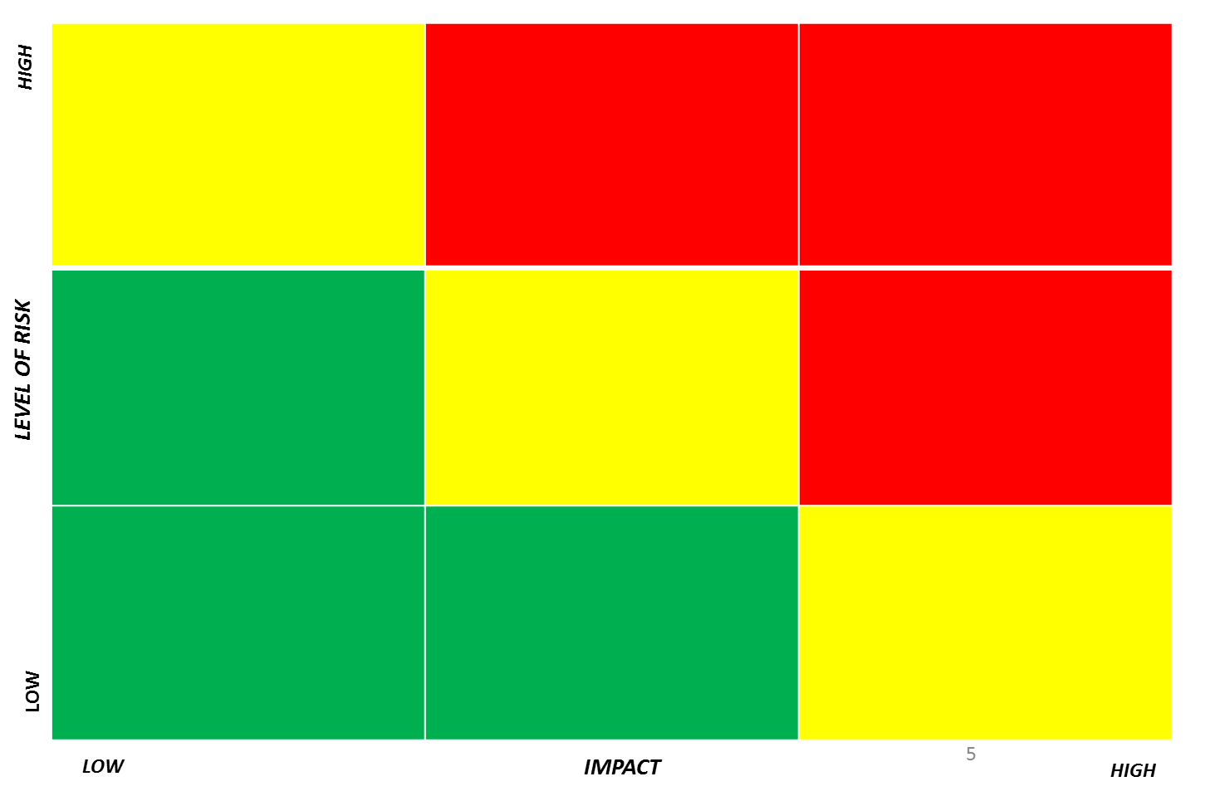
1
2
3
4
5
6
7
8
9

Slide 43
Shared Practices
What has been an effective approach and/or control for you?

Slide 44
CODE IMPLEMENTATION WORKSHOP (7 SEPTEMBER)
BIOPHARMACEUTICAL SECTOR
CLOSING OBSERVATIONS
Ms. Chrisoula Nikidis
Vice President, Ethics, Integrity and Governance
Innovative Medicines Canada

Slide 45
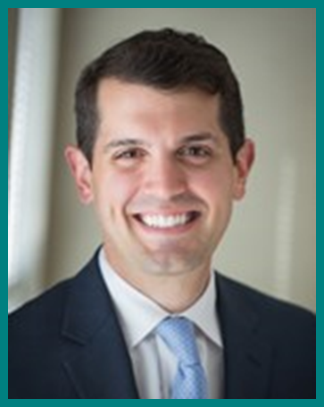
CODE IMPLEMENTATION WORKSHOP (7 SEPTEMBER)
BIOPHARMACEUTICAL SECTOR
GUIDANCE FOR PLENARY DIALOGUE (8 SEPTEMBER)
Mr. Andrew Blasi
Associate Director
C&M International

Slide 46
CODE IMPLEMENTATION WORKSHOP (7 SEPTEMBER)
BIOPHARMACEUTICAL SECTOR
PLEASE JOIN THE
BIOPHARMACEUTICAL SECTOR RECEPTION
LAKE SIDE GARDEN, SHERATON HANOI
(17:30-19:00)

