Slide 1


2015 APEC Business Ethics for SMEs Forum
Biopharmaceutical Sector Workshop
19 August 2015│ Manila, Philippines

Slide 2
Ms. Lynn Costa
Project Overseer, Business Ethics for APEC SMEs Initiative
Senior Policy Advisor for Global Markets
U.S. Department of Commerce
The United States

Slide 3
Participant Introductions &
Status Updates by Associations

Slide 4
SESSION ONE
Association Leadership in Strengthening Ethical Practices

Slide 5
Session One: Association Leadership in Strengthening Ethical Practices
Moderator: Ms. Maria “Maru” Quindimil (The Philippines)
Panelists:
Ms. Deborah Monk, Medicines Australia (Australia)
Ms. Chrisoula Nikiidis, Rx&D (Canada)
Mr. Pan Guang Cheng, CPIA (China)
Mr. Darodjatun Sanusi, G.P. Farmasi (Indonesia)
Ms. Claudia Perez, ANAFAM (Mexico)

Slide 6
Deborah Monk
Director, Compliance
Medicines Australia

Slide 7

The Industry is Responsible for its Reputation
Failure to adhere to high standards negatively affects the whole industry’s reputation, not just one company’s

Slide 8
Why adopt a Code of Ethics?
A platform for demonstrating that companies’ interactions with healthcare professionals and patients are legitimate, and therefore should be permitted
A strong self-regulatory Code, effectively communicated and enforced, is our licence to operate
There is Strength in Unity in adopting ethical business practices

Slide 9
Industry Associations are a hub for...
Establishing a Code
Reviewing and revising the Code on a regular basis
Providing training for members and other organisations (e.g. agencies, third party vendors)
Monitoring compliance with the Code
Taking appropriate remedial action where non-compliance is detected
Communicating effectively to external parties about the ethical business practices of the industry

Slide 10
Session One: Association Leadership in Strengthening Ethical Practices
Moderator: Ms. Maria “Maru” Quindimil (The Philippines)
Panelists:
Ms. Deborah Monk, Medicines Australia (Australia)
Ms. Chrisoula Nikiidis, Rx&D (Canada)
Mr. Pan Guang Cheng, CPIA (China)
Mr. Darodjatun Sanusi, G.P. Farmasi (Indonesia)
Ms. Claudia Perez, ANAFAM (Mexico)

Slide 11
APEC Workshop
Session 1
Chrisoula Nikidis
Rx&D
Canada

Slide 12
Forces in the Universe
UK
Bribery Act
Individual Company Code
US Foreign Corrupt Practices Act
IFPMA
EFPIA Transparency Guidelines
Local Associations Codes
Health Care Professional Associations
Rx&D
Code of Ethical Practices
APEC
and
Mexico City Principles
Patient Group Codes
Canadian Corruption of Foreign Public Officials Act

Slide 13
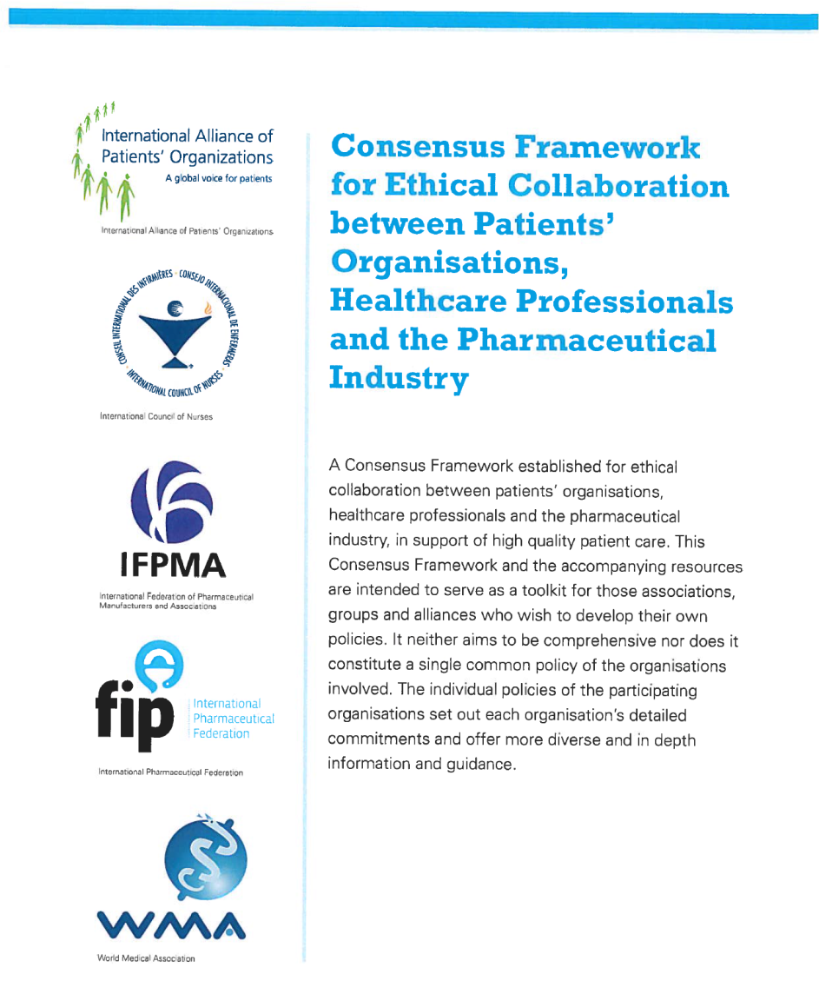
Consensus Framework for Ethical Collaboration
A consensus framework established for ethical collaboration between patients’ organisations, healthcare professionals and the pharmaceutical industry in support of high quality Patient care

Slide 14
Session One: Association Leadership in Strengthening Ethical Practices
Moderator: Ms. Maria “Maru” Quindimil (The Philippines)
Panelists:
Ms. Deborah Monk, Medicines Australia (Australia)
Ms. Chrisoula Nikiidis, Rx&D (Canada)
Mr. Pan Guang Cheng, CPIA (China)
Mr. Darodjatun Sanusi, G.P. Farmasi (Indonesia)
Ms. Claudia Perez, ANAFAM (Mexico)

Slide 15

推行医药企业伦理准则 营造健康医药产业环境
Promoting Ethics Principles in biopharmaceutical industry, building healthy environment of biopharmaceutical industry
中国化学制药工业协会常务副会长 潘广成
Standing vice president of China Pharmaceutical Industry Association
2015年8月19-20日 菲律宾·马尼拉
19-20 August, 2015 Manila Philippine

Slide 16
很高兴受邀参加本届APEC 中小企业商业道德论坛并与国外制药业同行进行交流
I am honored to attend 2015 APEC Business Ethics Forum and learn from our colleagues
中国化学制药工业协会（CPIA）是1988年9月经中国民政部批准正式注册的全国4A级行业协会。目前有316家会员单位，其主营业务收入和利润占化学制药行业60%以上
CPIA was registered in September 1988 and approved as a 4-A industry association by the Ministry of Civil Affairs of China.CPIA now has 316 members whose major business volume and profit covering more than 60% of the pharmaceutical industry in China.
下面，向大家介绍中国化学制药工业协会（CPIA）在推进实施《医药企业伦理准则》方面所做的工作及后续规划
The following is the report on the achievements and future plan by CPIA in the promoting executing ethics principles for biopharmaceutical enterprises.

Slide 17
改革开放三十多年来，中国经济发展创造了世界奇迹，中国医药行业更是以高于全国工业的整体增速迅猛发展
With the opening reform in over 30 years, the Chinese economic has made the world known achievements, the Chinese pharmaceutical industry has made the development even bigger and faster than the general industry increase.
2014年，中国医药工业主营业务收入达到2.45万亿人民币（约合3950亿美元）
In 2014, the major business revenue of the Chinese pharmaceutical industry reached 395 billion USD.

Slide 18
面对中国已成为世界第二大医药市场的现状，要在市场竞争中把握道德底线不动摇，必须坚持以诚为利，以信为赢
China is now the second largest pharmaceutical market,it is very important to hold stablely the ethics line, and sticting to faith and credit
随着中国医疗卫生体制改革的不断深化，业界要求自觉践行行业自律，倡导企业诚信合规经营的呼声日益高涨，在中国推行《医药企业伦理准则》的时机已经成熟
As the reform of the Chinese medical and health system is deepening, the industry is called to follow up more closely the industry principles. It is the time that 《the ethics principles for biopharmaceutical enterprises》 is being promoted in China.

Slide 19
2011年9月，亚太经合组织（APEC）在墨西哥提出了生物制药领域的商业道德准则——《墨西哥城原则》，为中国推进实施《医药企业伦理准则》提供了经验
In September 2011， APEC launched business ethics in Mexico (The Mexico City Principles) for biopharmaceutyical sector, which provides experiences for China to execute 《ethics principles for biopharmaceutical enterprises》
在当前中国药品安全形势比较严峻的背景下，发起推行《医药企业伦理准则》对于规范企业经营、重拾消费者对行业的信心都有积极作用
At present, in China, promoting the 《ethics principles for biopharmaceutical enterprises》 is very important for regulating the business operation and set up the confidence of people for the industry

Slide 20
一、将《墨西哥城原则》引入中国
Introducing (The Mexico City Principles) into China
2012年7月，CPIA受邀派代表参加了APEC在台北召开的“关于生物制药业志愿实施企业伦理准则草案研讨会”
In July, CPIA sent its representatives to attend in Taibei the "forum for biopharmaceutical enterprises to executing voluntarily the ethics principles"
2012年8月，CPIA受邀参加了APEC在吉隆坡举办的“生物制药行业、医疗器械行业、建筑工程行业商业道德自愿行动准则培训班”
In August 2012, CPIA was invited to attend the training course organized in Kuala Lumpur for "biopharmaceutical sector, medical device sector and construction/engineering sector to practice voluntarily the business ethics

Slide 21
2013年8月，CPIA与中国医保商会、中国药促会商榷并达成共识，将《墨西哥城原则》引入中国，中国译本定名为《医药企业伦理准则》
In August 2013, CPIA, CCCMHPIE, PHIRDA discussed and agreed to introduce (The Mexico City Principles) into China, which it named as 《ethics principles of biopharmaceutical enterprises》in Chinese
2013年11月，在“中国化学制药行业年度峰会”上，有5家医药行业协会推出了《医药企业伦理准则》
In November 2013, in the "annual summit meeting of Chinese biopharmaceutical industry", 5 industry associations proposed《ethics principles of biopharmaceutical enterprises》

Slide 22
二、成功举行了三次专题会议
Held successfully 3 special meetings
2013年10月29日，“中国医药企业伦理准则发布大会”在中国北京举行，9家中国医药协会当场签署了《医药企业伦理准则》倡议书
29 October 2013, the Launching meeting of ethics principles for Chinese biopharmaceutical enterprises was held in Beijing, 9 industry associations signed on site the initial written proposal of《ethics principles of biopharmaceutical enterprises》
2014年5月27日，在北京举办了“医药企业伦理准则中国论坛”，对《医药企业伦理准则》做更深层次的推动。在此推动下，中国医师协会颁布了《中国医师道德准则》，《医药企业伦理准则》在中国的推广取得了实质性进展
May 27, 2014, "China Forum of ethics principles of biopharmaceutical enterprises" was held in Beijing which further promote the execution of 《ethics principles of biopharmaceutical enterprises》.on the same period, the association of Chinese doctors launched 《ethics principles of Chinese doctors》.The promoted and execution of 《ethics principles of biopharmaceutical enterprises》in China have achieved practice progress.

Slide 23
2015年6月29日，9家医药协会在北京召开“2015医药企业伦理准则中国论坛”，主题为“多方联动 践行合规”，旨在加强医药卫生行业以及监管机构之间的协同。本次论坛新增8家医药行业相关协会签署了《医药企业伦理准则倡议书》，截至目前，中国已有17家医药相关行业协、会加入到了倡导《医药企业伦理准则》中来，具有广泛的代表性
29 June 2015, 9 pharmaceutical associations held in Beijing the "2015 China Forum of ethics principles of biopharmaceutical enterprises", the major topic was "multi action, practice ethics" with the purpose of enhancing the co-action of pharmaceutical and medical industry with the supervising authorities.This forum had added 8 new pharmaceutical related associations to sign on site the initial written proposal o《ethics principles of biopharmaceutical enterprises》.Up to now, in China, there are 17 pharmaceutical related associations joined the promotion of《ethics principles of biopharmaceutical enterprises》.
June,

Slide 24
三、推行《医药企业伦理准则》规划安排
Plan in promoting 《ethics principles of biopharmaceutical enterprises》

Slide 25
总体规划：加大宣传推广力度，开展合规政策、流程的培训，让更多的中小企业积极参与进来；加强与政府相关部门及利益相关方的互动沟通，及时向企业传达最新信息
General plan: increase propaganda and promotion, hold more trains on compliance policies and procedures, asking more MSEto join in; enhance the communication and exchange with the government authorities and stakers, and pass the newest information in time to the enterprises

Slide 26
（一）与利益相关方建立合作伙伴关系
Setting up collaboration partnership with stakers
（二）利用各种渠道开展多种形式培训
Conducting various training based upon different channels
（三）加强与政府各相关部门沟通协调
Increase communication and coordination with government authorities

Slide 27
（四）在行业内深入开展信用评价工作
Carry out credit evaluation work in the biopharmaceutical industry
（五）在调研基础上积极开展宣传推广
Conduct proganda and promotion based on the research
（六）在总结经验基础上完善准则内容
Optimize the content of the principles based upon the summarization
of experiences

Slide 28
我们坚信，只要我们持续不断地将《医药企业伦理准则》推行下去，在国家政策的支持下，在各行业协会、各企业、各利益相关方的参与和共同努力下，这项工作一定会取得令人瞩目的成果，一定能为中国的医药行业创造一个健康、有序的市场环境。
We believe that based upon our insistence on promoting 《ethics principles of biopharmaceutical enterprises》,supported by the policy of the country, with the participation and efforts of all industry associations, enterprises and stakers,this work will surely obtain outstanding achievements, and create a health and order market environment for the pharmaceutical industry in China.

Slide 29
Session One: Association Leadership in Strengthening Ethical Practices
Moderator: Ms. Maria “Maru” Quindimil (The Philippines)
Panelists:
Ms. Deborah Monk, Medicines Australia (Australia)
Ms. Chrisoula Nikiidis, Rx&D (Canada)
Mr. Pan Guang Cheng, CPIA (China)
Mr. Darodjatun Sanusi, G.P. Farmasi (Indonesia)
Ms. Claudia Perez, ANAFAM (Mexico)

Slide 30




Leadership in Strengthening Ethical Practices
(27 Mexican Companies)
(96 Mexican &
Multinational Companies)
Council of Ethics of the Pharma Industry
Ethics
Code

Slide 31
Benefits for Being Affiliated
  Adoption of the Code of Ethics of the Pharma Industry issued by CETIFARMA
  Revise and up date of the Code every 3 years
  Provides monitoring compliance with the Code
  Provides advisory or training about the Code if requested by companies
  Grants a Certification on Transparent Practices (EPT) to affiliates (a process of appraisal is requiered)
  Takes appropriate action when non-compliance is detected or reported by an affiliated
  Fosters approaching to health authorities, health care professionals, hospitals
  Is a communication link between the Industry and different health Authorities
  Establishes good relationships with international self-regulation organizations like IFPMA to get knowledge and promote ethical business practices of the industry in other countries

Slide 32
SESSION TWO
Best Practices for
Low Cost Implementaton of Codes of Ethics

Slide 33
Session Two: Best Practices for Low Cost Implementation of Codes of Ethics
Scene-Setting Remarks:
SME Perspective: Mr. Butch Sales (The Philippines)
Association Perspective: Sabrina Chan (Hong Kong)
Exercise Facilitator:
Ms. Karen Eryou, UCB (China)

Slide 34

The Role of the Industry Association on Code of Practice
Sabrina Chan
Executive Director
The Hong Kong Association of the Pharmaceutical Industry
August 2015

Slide 35
Myths of implementing Code of Practice
Is implementing the Code costly?
Is implementing a Code time consuming?
Is promoting a Code need a lot of additional human resources?
Will I lose the market
  if my company does something different from other companies (which do not comply with the Code Of Practice); or
  if my company does something different from the previous practice by which I will lose my existing customers

Slide 36
Some Business Questions
Business opportunities vs. risk management considerations?
How to run a company in compliance with local law?
How to run a company to meet the expectation of customers/society?
How to run a company in compliance of company practice and rules - a proper corporate governance in the company?
How to run a company in accordance to the standard of the local industry?
Can you distinguish your market from the others by providing benefits?

Slide 37
HKAPI: Background & Mission
Formed in 1968;
Membership
Full members: 41 R&D based multinational companies
  supply 70% of prescription medicine in Hong Kong
Affiliate members: 1 R&D based multinational companies with no pharmaceutical product launched in HK
Associate members: 32 companies providing services to our full members, including Clinical Trial Centre of Universities of Hong Kong, law firms and PR firms; also medical devices companies
Mission – to ensure patients have expedient access of innovative and effective drug to enhance better health and quality of life in Hong Kong

Slide 38

The role of the Association - Develop a Code and Revisit the Code periodically
Historical Milestones
Date | Event
March 2010 | The 14th edition of the Code of Marketing Practice is adopted.
March 2009 | The constitution was amended to provide greater simplicity and clarity.
June 2008 | 40th Anniversary of HKAPI.
April 2008 | The 13th edition of the Code of Marketing Practice was adopted.
July 2007 | IFPMA Code Compliance Network - Train the Trainer session held in Singapore.
April 2007 | The 12th edition of the Code of Marketing Practice was adopted.
February 2007 | IFPMA Code Compliance Network - Asia Roll Out Meeting held in HK.
April 2006 | The 11th edition of the Code of Marketing Practice was adopted.
April 2005 | The 10th edition of the Code of Marketing Practice was adopted.
April 2000 | The 9th edition of the Code of Pharmaceutical Marketing Practice was adopted.
April 1999 | The 8th edition of the Code of Pharmaceutical Marketing Practice was adopted.
November 1997 | 1st IFPMA Asian Regulatory Conference was jointly organized by IFPMA and the HKAPI. The Regulatory and Clinical Aspects of Bio- equivalence meeting, organized by the HKAPI.
March 1997 | The 7th edition of the Code of Pharmaceutical Marketing Practice was adopted.
March 1996 | The 6th edition of the Code of Pharmaceutical Marketing Practice was adopted.
March 1993 | The 5th edition of the Code of Pharmaceutical Marketing Practice was adopted.
October 1992 | HKAPI Executive Director elected to the Council of IFPMA, 1992-94. HKAPI delegation to China.
March 1990 | The 4th edition of the code of Pharmaceutical Marketing Practices was adopted.
March 1988 | The first awards of "Cert.Med.Rep. (HKAPI)" were made to the 64 successful candidates in the examination at the end of the 1987/88 Training Programme.
January 1986 | A revised and expanded 3rd edition of the Code of Pharmaceutical Marketing Practices was adopted.
15 November 1973 | IFPMA Council Meeting held in Hong Kong.
September 1971 | HKAPI as a member of the International Federation of Pharmaceutical Manufacturers and Associations (IFPMA).
18 March 1970 | Code of Marketing Practice for Medical Specialties unanimously adopted at Second Annual General Meeting.
20 June 1968 | HKAPI registered under Societies Ordinance.

Slide 39
Key references for building /revising a code
The Hong Kong Code incorporates the principles set out in:
  The International Federation of Pharmaceutical Manufacturers and Associations (IFPMA) Code of Pharmaceutical Marketing Practice
  The World Health Organization’s Ethical Criteria for Medicinal Drug Promotion
  The Mexico-City Principles
Leveraging professional knowledge
  Learning from members
  Learning from Associate members
  Learning from law enforcement party ( e.g. Independent Commission Against Corruption)
  Learning from Case Law
  Learning from stakeholders ( Public Hospitals, Physicians, Pharmacists, Patients, Consumer Council)

Slide 40
The Code revision – the process of alignment
A task force set up with Compliance officers, Medical/regulatory directors and Legal Advisers
The Code to be effective
The Task Force review the content as a whole and clauses in different section – divided by groups, discussed the revision, clause by a clause
Tap the input from outside stakeholders
Present to the Board of Directors - Task force Reviewed the comment of Board of Directors - Submitted the final version to the Board for final approval
EGM – Approve all the clauses and agreed an implementation date

Slide 41
Promotion of Code internally
Training workshops
  Cert med. rep. course
  Train-the-trainer workshop
    At least identified a ‘responsible person’ to join
    Cases studies
A survey to develop some KPIs to check the progress of development and identifying the areas of future training
A workshop to be held in another half of the year.

Slide 42
KPIs to measure success
Stage 1: Align internal SOP with CoP through member survey
  Quantitative:
  No. of questions received from compliance officers
  Any dedicated officer in the company
  Frequency of training conducted in the past year
  Any internal SOP set up
  Are those SOPs aligned with CoP
  Qualitative:
  Type of questions raised
  Process to track internal compliance
  Which part of CoP need improvements
Stage 2 : Ethical thinking in every decision making
  Workshop with cases help members understanding each participating companies’ and knowledge gap.

Slide 43
Promotion of Code – leverage the relationship with stakeholders
 | Target Receiver | Channel | Objective | update
External | Public |  | Inform public about the spirits and principles of our Code and enhance industry’s image | The code is on the website
 |  | Website
 | Organizations/ Associations (local & overseas)e.g. Consumer Council, HKMHDIA, | MEHK seminars/Briefing meetings; association meeting | Promote our Code to overseas Event organizers | Via HK tourism Board
 |  |  | Further discuss the co-promotional activities e.g. Medical Devices Association | Meeting done and the association will put forward to plan to make it mandatory
 | Doctors/Healthcare Professionals e.g. HKMA, FMSHK, Doctors Union, PPA, PSHK, SHPHK, PCCC | By mailing/meetings with HKMA and doctors union/MEHK Associations meeting (gather all the medical associations for a briefing) Letters to council heads Journal adv to highlight key messages and link of COP | To understand our marketing practices and responsibilities in providing accurate information on members’ products | Have sent letters to associations all regarded stakeholders An advertisement on the July, medical Journal
 | Government Stakeholders e.g. Food & Health Bureau, LegCo members, HA, DH, PPB | By mailing/face-to-face meetings | To ensure our business practices should conform to all relevant laws and regulations of Hong Kong and Macau | Mail sent Met legco members – Joe Lee, Helena Wong
 | Patient Groups | By mailing/patient groups’ activities | Promote our commitment to the improvement of patients’ quality of life | Mail sent with their acknowledgement
 | Universities e.g. HKU & CUHK | By educational talks | Through the universities to educate the pharmacy students about our industry’s code of practice | A seminar every year…
 | Other Stakeholders | Newsletter | To reach some stakeholder may not know about our Code | Will reinforce the message in the June version

Slide 44
Myths of implementing Code of Practice
Is implementing the Code costly?
Is implementing a Code time consuming?
Is promoting a Code need a lot of additional human resources?
Will I lose the market
  if my company does something different from other companies (which do not comply with the Code Of Practice); or
  if my company does something different from the previous practice by which I will lose my existing customers

Slide 45
Prevention of Bribery Ordinance (POBO)
Enacted in 1971
Enforced by Independent Commissioner of Corruption
Under the POBO, it is not a statutory defence to show that an advantage is of de minimis value or that it is customary to any profession, trade, vocation or calling to accept the advantage. However, it is a general defence for any person to prove that he had offered, accepted or solicited the advantage with lawful authority or reasonable excuse.

Slide 46
No misleading information/off-label promotion
False labelling and advertisement of food or drugs
  Cap 132 Public Health and Municipal Services, enforce by Food and Health Bureau
Misleading information, misleading omissions, bait advertising:
    Cap 362 Trade Description Ordinance, enforced by Custom and Excise
Off-label promotion
    - Code of Practice: IFPMA, PhrMA, JPMA, HKAPI

Slide 47
Session Two: Best Practices for Low Cost Implementation of Codes of Ethics
Scene-Setting Remarks:
SME Perspective: Mr. Butch Sales (The Philippines)
Association Perspective: Sabrina Chan (Hong Kong)
Exercise Facilitator:
Ms. Karen Eryou, UCB (China)

Slide 48
APEC Biopharmaceutical Workshop Structure for Session 2
Pre-Workshop
Needs Assessment Survey
Examples
Based on outcome of survey, set up “expert forums” (i.e. 2-3 of our industry mentors) who are expertise on a topic identified in survey (i.e. influencing skills) listen to association/s challenges and troubleshoot, offer advice.
Output, Challenges, Benefits
Challenges:
Benefits:
Influencing skills/persuading on first time code adoption
Re-energizing on further code implementation (for association that have taken first step, but need more support/advice
2-3 examples of communication campaigns on codes
Creating low to non-cost process (writing SOPs)
Best Practices on managing a complaint between members
Workshop
After 20 minutes, facilitator rings a bell, and association physically move to another pre-chosen table for their next consultation with a new expert forum.
In an hour, an association could rotate through 2 experts forums to seek advice on 2 different challenges.
Associations should pre-select expert forum (assign if no pre-selection)
Good classroom organisation and instructions (slides and mentors prepared)
Attendees moving about and meeting many people in short timeframe
Will help socialize the group for later conversations
Session Output: each association develops 2-3 actions per challenge area that will move them along on the road to code effectiveness once back to their country.
Association completes and “action card” listing 2-3 actions based on expert advice

Slide 49
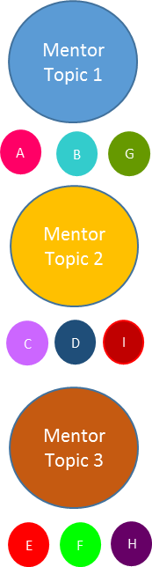
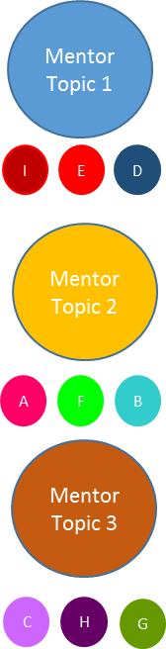
APEC Biopharmaceutical Workshop Structure for Session 2
Pre-Survey to Workshop Day
Workshop Topic: Best Practices for Low Cost Implementation of Codes of Ethics
Pre-workshop survey of Associations to determine challenges *
Prior to workshop: Match Associations with mentor tables based on survey results
First Matching – Associations move to their mentor tables per pre-selected topic (20 min)
Associations move to their second matching per pre-selected topic (20 min)
Associations completes actions cards with take-away suggestions from mentor discussions
Associations completes actions cards with take-away suggestions from mentor discussions
Wrap Up (5 min)
Workshop Day: Scene-Setting Remarks (5-7 minute each)
* Suggested Topics - see word doc

Slide 50
Table Topics & Mentors
TABLE A – Handling Objections | TABLE B – Government Relations
Mentor: Neil Pratt | Mentor: Deborah Monk
TABLE C – Handling Objections | TABLE D – Government Relations
Mentor: Maija Burtmanis | Mentors: Teodoro Padilla & Ricardo Licsi
TABLE E – Handling Objections | TABLE F – Government Relations
Mentor: Maru Quindimil | Mentor: Busakorn Lerwatanasivalee
TABLE G – Next Steps on Code Implementation | TABLE H – Government Relations
Mentor: Genevieve Wan | Mentor: Chrisoula Nikidis / Russell Williams
TABLE I – Next Steps on Code Implementation | TABLE J – Toolkits
Mentor: Karen Choi | Mentor: Sabina Sudan
TABLE K – Next Steps on Code Implementation | TABLE L – Toolkits
Mentors: Reiner Gloor / Alvin Navarro | Mentor: Sabrina Chan
TABLE M – Next Steps on Code Implementation | TABLE N – Toolkits
Mentor: Fortune Lopez | Mentors: YS Kwon / Katsumi Kojima
TABLE O – Next Steps on Code Implementation | TABLE P – Toolkits
Mentor: Masood Ahmed | Mentors: Joseph Cho / Henry Li

Slide 51
Session Two: Best Practices for Low Cost Implementation of Codes of Ethics
Scene-Setting Remarks:
SME Perspective: Mr. Butch Sales (The Philippines)
Association Perspective: Sabrina Chan (Hong Kong)
Exercise Facilitator:
Ms. Karen Eryou, UCB (China)

Slide 52
LUNCH BREAK
(Luzon Room – Next Door)
11:30 – 13:00

Slide 53
CODE IMPLEMENTATION WORKSHOP

Slide 54
Thermometer Game
Exercise Lead:
Ms. Chrisoula Nikidis, Rx&D (Canada)

Slide 55
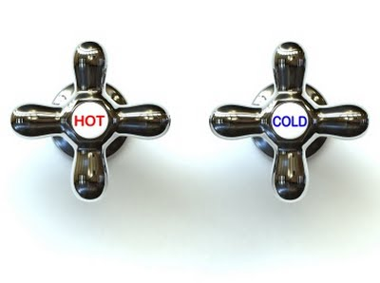
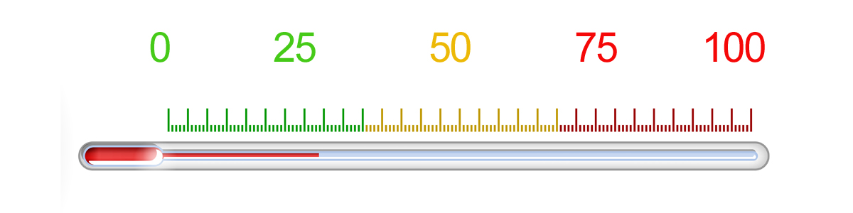
How hot is this issue?
Where on the temperature scale do you place it?
Why?
What response is needed?
How could it be prevented from occuring again?

Slide 56
Case Study: Interactions with Health Care Professionals
Exercise Lead:
Mr. Neil Pratt, PhRMA (United States)

Slide 57
Case Study: Interactions with Third Parties
Exercise Lead:
Mr. YS Kwon, Johnson & Johnson (Singapore)

Slide 58
COFFEE & NETWORKING BREAK
15:30-16:00

Slide 59
SESSION THREE
Multi-Stakeholder Partnership to Strengthen Ethical Business Practices

Slide 60
Session Three: Multi-Stakeholder Partnership to Strengthen Ethical Business Practices
Panel Session Members:
Moderator: Mr. Russell Williams, Rx&D (Canada)
Panelist: Hon. Kenneth Hartigan-Go, Department of Health (The Philippines)
Panelist: Dr. Masami Ishii, Japan Medical Association (Japan)
Panelist: Dr. Chairat Shayakul, Rational Drug Use Subcommittee (Thailand)
Panelist: Mr. KP Tsang, Chair, International Alliance of Patients Organizations (Hong Kong)

Slide 61
Biopharmaceutical Business Ethics and Stakeholder Partnership in Thailand
Chairat Shayakul
Healthcare Professional
Service Provider: Public & Private Hospital, Clinic, Drug Store
Association: Physician, Pharmacy, Dentist, Nurse, Veterinarian
Payers
Civil Servant Medical Benefit Scheme (7 million gov. workers)
Patient and Community
Consumer protection office
Biopharmaceutical Business
GPO, PReMA (35 Co’s), TPMA (65 Co’s)
Pharma Co’s under no membership (several hundreds)
Social Security Scheme (10 million private workers)
Universal Coverage Scheme (50 million Thais)
Professional Teaching Institutes
Multi-Stakeholder Partnership to Strengthen Ethical Business practices: 19 August 2015

Slide 62
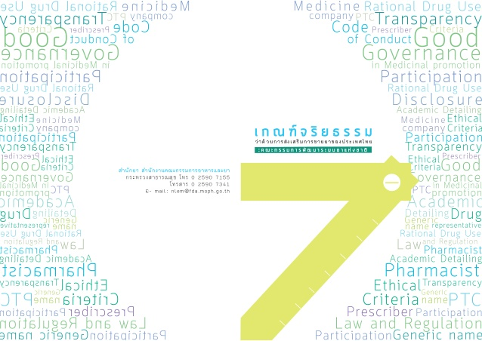
Participatory Actions
Domain 1 Definitions
Domain 2 Prescribers
Domain 3 Executives or Authorities
Domain 4 Pharmacists
Domain 5 Pharmaceutical Companies and
Representatives
Domain 6 Healthcare service, Pharmacy
Service or Agencies which
related to drug procurement
Domain 7 Professional Schools
Ethical Criteria for Medicinal Drug Promotion in Thailand (2014)
Setup: working group comprising all parties with no interest in local or international pharmaceutical business
Public hearing for applicability
Implementation / action
Announcement

Slide 63
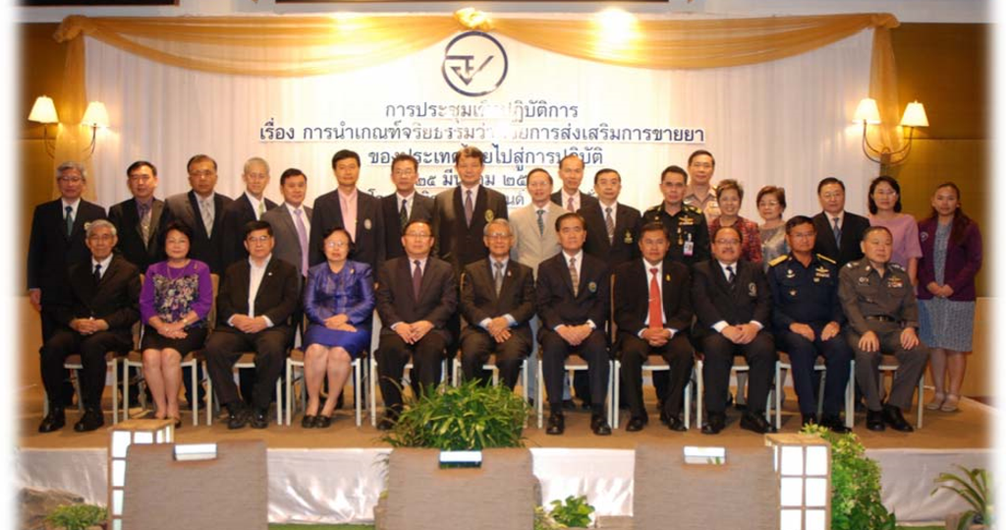
Establishment of Ethical Criteria for Medicinal Drug Promotion in Thailand
MOU signing ceremony (25 March 2015)

Slide 64
Session Three: Multi-Stakeholder Partnership to Strengthen Ethical Business Practices
Panel Session Members:
Moderator: Mr. Russell Williams, Rx&D (Canada)
Panelist: Hon. Kenneth Hartigan-Go, Department of Health (The Philippines)
Panelist: Dr. Masami Ishii, Japan Medical Association (Japan)
Panelist: Dr. Chairat Shayakul, Rational Drug Use Subcommittee (Thailand)
Panelist: Mr. KP Tsang, Chair, International Alliance of Patients Organizations (Hong Kong)

Slide 65
CLOSING SESSION &
WORKSHOP GROUP
PHOTOGRAPH

Slide 66
Closing Session and Workshop Group Photograph
Closing Remarks:
Mr. Russell Williams, Rx&D (Canada)
Review of Plenary Session Procedures:
Mr. Andrew Blasi, C&M International (United States)
Workshop Group Photograph

Slide 67
2015 APEC Business Ethics for SMEs Forum
Biopharmaceutical Sector Workshop
19 August 2015│ Manila, Philippines

Slide 68
2015 APEC Business Ethics for SMEs Forum
Biopharmaceutical Sector
Reception (Boracay Room)

